Slide 1
Family Size Anaerobic Digester in Mexico
University of the West – Sustainable Investing Club
Bio Impacto
Farbod Safaei, Juan Valencia, Lam Le

Slide 2
Work in Process
Total Project Cost
Anaerobic Overview
Government Subsidy
Technical Aspects
Social & Environmental Aspects
Economic Aspects
Project Costs & Possible Returns
Micro
Financing
Cost to System Owner
Upfront Investment
Sales of Carbon Credits

Slide 3
Biogas vs. Other Fuels
Fuel | Specific Energy (MJ/Kg) | Energy Density (MJ/L) | Energy Per CO2 (MJ/Kg) | Notes
Animal Manure | 10-15 | N/A | N/A | Common respiratory diseases Increased infant mortality.
Wood | 16-21 | 3-22 | 9-11 | Poor labor efficiency Deforestation and desertification.
Charcoal | 30 | N/A | 8 | Low particulate matter High Carbon Monoxide Inefficient production process
Ethanol | 23-27 | 18-21 | 12-14 | Reduces food supply Very clean burning
Natural Gas | 38-50 | 26-29 (Liquefied) | 13-17 | Very efficient burning Fossil fuel Produces Propane as a by-product
Biodiesel | 37.8 | 33-36 | 13 | May be renewable
Biogas | 55 | 23 (Liquefied) | 20

Slide 4
Problems & Opportunities in Mexico
Feedstock (Manure & Crop Waste)
Waste Management (Black Water)
Import Gas from the U.S
Access to Electricity and Gas
Electricity Price
Natural Gas Price
Notes:
Mexico 2005 (1990) vs
15.5 Kilograms per capita of bovine (11.8)
15.3 Kilograms per capita of pigs/hogs/porcine (10.8)
U.S. 2012 (1997, 1990)
24.77 Kilograms per capita of bovine (28.9, 29)
US Electricity prices: http://www.eia.gov/electricity/monthly/epm_table_grapher.cfm?t=epmt_5_6_a
MEX: http://egob2.energia.gob.mx/portal/electricidad.html
SENER data: http://egob2.energia.gob.mx/portal/electricidad.html
http://www.sener.gob.mx/portal/Default_Intermedia.aspx?id=2615
Ranching and Agriculture: http://www.sagarpa.gob.mx/Paginas/default.aspx
Mexican Fertilizer Supplier Prices: http://www.sagarpa.gob.mx/agricultura/Precios/Paginas/ProveedoresdeFertilizantes.aspx

Slide 5
Anaerobic Digestion Overview
Heat
Anaerobic Digestion
Bio Waste
Biogas
CHP
Electricity
Bio Fuel
Fertilizer

Slide 6
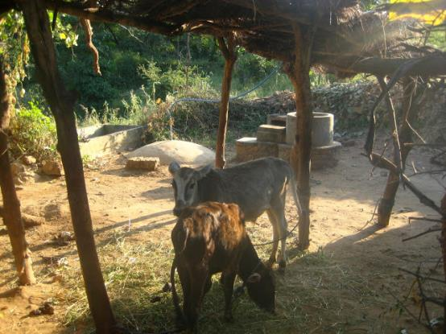
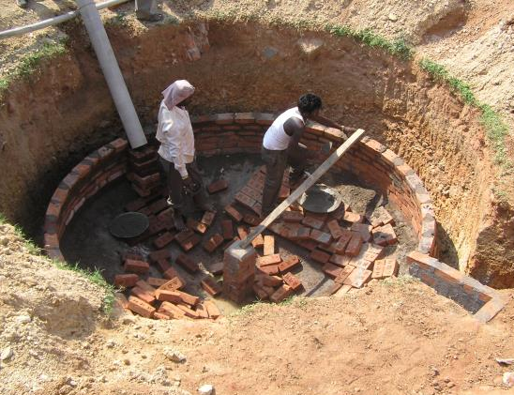
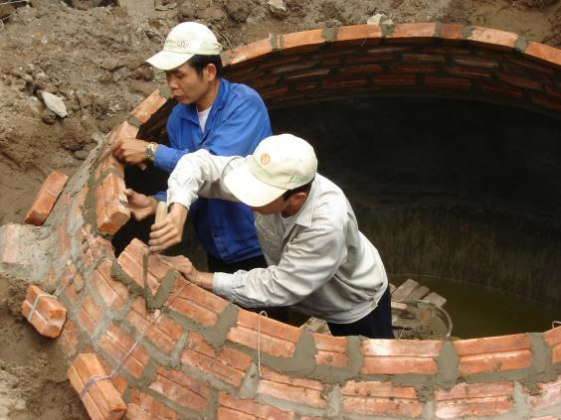
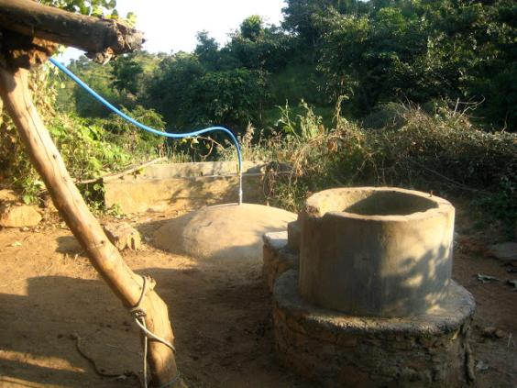
Fixed Dome Anaerobic Digestion
Pros
Low cost
No moving parts, long life
No rusting parts
Underground construction
Local employment
Cons
May become porous or crack
Biogas pressure fluctuates
Cooler than ideal temperature
Notes:
Average 11 days to build the dome

Slide 7
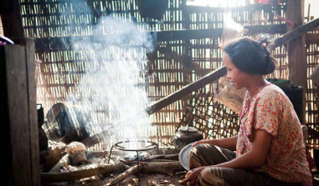
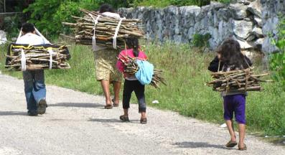
Environmental Benefits
Saving of Firewood
2,000 kg per year
Saving of Kerosene
32 liters per year
Reduction of Greenhouse Gas
Emissions
4,900 kg CO₂ per year
=
1 AD
Improvement of Air, Water Quality
Reduction of Deforestation and Degradation
Source: Biogas Support Programme (BSP) Nepal
Notes:
Vietnam Biogas Programme 2012 Objective
1) to increase the number of family-sized, quality biodigesters to 164,000 units in 58 provinces; 2) to reduce workload for women (from fuelwood gathering) by 109 million hours per year (1.8 hours per day); 3) to increase the amount of livestock grown at 67% of the biodigester households; 4) to save between 10-14 Euros per month on reduced fuel/household costs for 65% of the 164,000 purchasing households; 5) to increase crop yields by 5-20% for farming households due to the use of the effluent bio-slurry as a fertilizer and saving on chemical fertilizer costs; 6) establishing 1,200 mason teams of 5-7 people who will act as small businesses to sell and locally construct biodigesters, thereby also creating thousands of man-hours of employment; 7) create 1.5-3 tonnes of CO² equivalent per year per digester of tradable emission rights; 8) have at least 75,000 of the units sold include a personal toilet attachment; 9) establish clean farms with no animal dung pollution; and 10) increase health of the families through better hygiene and sanitation from the better treatment of feces.

Slide 8
Social Benefits
Reduction of Workload (Cooking + Collecting)
1,100 hours per year (3 hours per day)
Improvement of Sanitation
And Health (Human & Animal)
Reduced disease outbreaks
Reduced per capita spending on healthcare
=
1 AD
Energy Independent Households
Creation of Employment and Economic Activities
Source: Biogas Support Programme (BSP) Nepal
Notes:
In a study done by Nguyen Quoc Chinh of the Faculty of Economics and Rural Development of Hanoi Agriculture University, she investigated the health perceptions of 12 farmers. She asked them to compare the symptoms of runny nose and headaches before and after biogas systems were installed. She also asked the rate of doctor visits for the two periods. 66% of
the respondents claimed they had runny noses on a non regular basis, 100% of them
said they had none after the system was installed.

Slide 9
Economic Benefits
Savings of Fuel Cost
$140 - 200 per year
Increase Crop Yield (Using Fertilizer)
5-20%
67%
Increase of Livestock Production
=
1 AD
$ 515
Source: Vietnam Biogas Programme

Slide 10
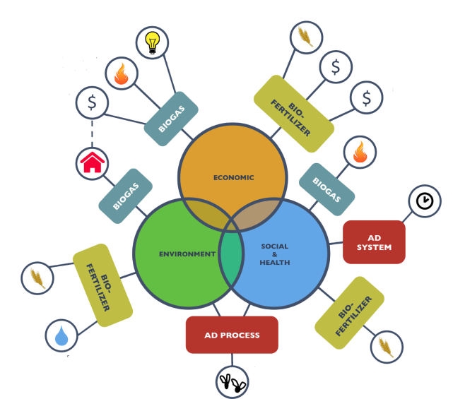
Benefits Summary
Reduced Chemical Fertilizer Cost
Reduced Electricity & Fuel Cost
Increased Production of Crop & Livestock
Income from Credits Sales
Reduced risk of waterborne and respiratory disease
Reduced GHG
Time savings
Improved Soil Conditioning
Less Pollution, Less Chemical Fertilizer, Less Waste to Water System
Reduced Chemical Fertilizer in Food Production
Better Waste Management

Slide 11
Construction Costs
Material | Quantity | Cost (in 1000 VND)
Cement | 1.1 tons | 1,512
Solid | 3500 pieces | 3,150
Sand | 3m3 | 600
Gravel | 1.5m3 | 300
Pipes | 3.5m | 580
Steel | 15kg | 180
Conductor Wire | 30 m | 210
Manometer | 1 piece | 40
Valves | 1 set | 100
Biogas Using Device
Biogas single cooker | 1 | 500
Lamp | 1 | 70
Labor |  | 3,760
Total |  | 11,002

Slide 12
Project Financing
Total Project Cost
Government Subsidy
Micro
Financing
Cost to System Owner
Upfront Investment
Sales of Carbon Credits

Slide 13
Government Subsidy
Banco de Desarrollo (Mexican Development Bank)
Business
Infrastructure
Financiera Rural
Rural
Housing
FIRA
Up to 50% (Project Under $1 MXN)
Notes:
The Mexican Development Bank falls under the Ministry of Finance and Public Credit (Secretaria de Hacienda
y Credito Publico, SHCP). The Bank has four sectors of attention; Business Sector, Infrastructure Sector, Housing
Sector and Rural Sector. Under the Rural Sector the Bank distributes funds to Financiera Rural, FIRA and FOCIR
(Fund for Capitalization and Investment in the Rural Sector)

Slide 14
Carbon Credits Sales
CMD
vs.
Voluntary
Pros:
More attractive
Higher values and more predictable
Cons:
Complicated & Expensive Procedures
Small size project
Pros:
Less standardized
Less effected by CDM commitment period
Cons
Less potential buyers
Notes:
What is the clean development mechanism?
The CDM allows emission-reduction projects in developing countries to earn certified emission reduction (CER) credits, each equivalent to one tonne of CO2. These CERs can be traded and sold, and used by industrialized countries to a meet a part of their emission reduction targets under the Kyoto Protocol.
Voluntary Emission Reductions or Verified Emission Reductions (VERs) are a type of carbon offset exchanged in the voluntary or over-the-counter market for carbon credits.^{[1]} Verified Emission Reductions are usually certified through a voluntary certification process.^{[2]}
Verified Emission Reductions are usually created by projects which have been verified outside of the Kyoto Protocol. One VER is equivalent to 1 tonne of CO2e emissions.^{[3]} Through these schemes, industries and individuals voluntarily compensate for their emissions or provide an additional contribution to mitigating climate change.
https://cdm.unfccc.int/methodologies/index.html
https://cdm.unfccc.int/filestorage/k/_/C0L5JZ6MBYPDUNF1Q73RE98XVA24TW.pdf/EB%2068_repan25_Rev_%20AMS-I.I_ver4.0.pdf?t=RnN8bmZlcmd3fDDanWvyNr_jMnexDkobd-ib

Slide 15
Micro-Financing
Private Equity
Micro
Financing
P2P Lending
Philanthropic Organization

Slide 16
Work in Process 2.0
Detailed Working Plans
Sustainability Metrics
Financing Plan
Government Subsidy
Micro
Financing
Sales of Carbon Credits

Slide 17
Thank You Q&A

